Slide 1
Probability Distributions
“Probability theory is nothing but common sense reduced to calculation” ¹

Slide 2
Density estimation: To model the probability distribution p(x) of a random variable x, given a finite set {x₁, . . . , x_{N}} of observations.
Parametric distributions: binomial and multinomial distributions for discrete random variables and the Gaussian distribution for continuous random variables.
Why parametric?
How to estimates these parameters given an observed dataset? We choose specific values for the parameters by optimizing some criterion, such as the likelihood function.
What's the limit of parametric approach?
Nonparametric density: the form of the distribution typically depends on the size of the dataset.
Why non- parametric?

Slide 3
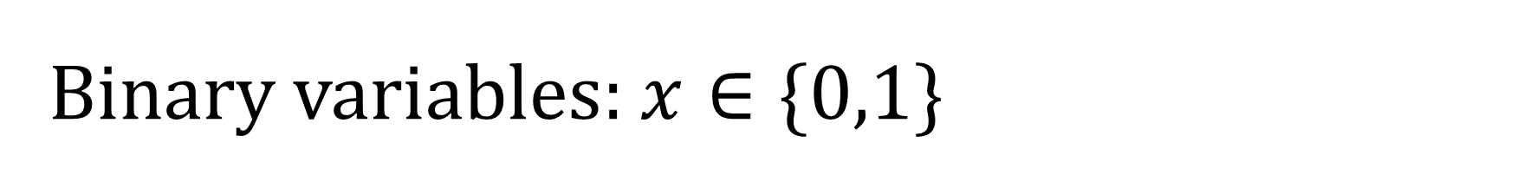
Binary variables: $x∈\{0,1\}$
Bernoulli distribution:
Now suppose we have a data set D = {x₁, . . . , x_{N}} of observed values of x (independently).
MLE:

Slide 4

Sufficient statistic: The log likelihood function depends on the N observations $x_{n}$ only through their sum$\sum_{n}{x_{n}}$.
Why we call $\sum_{n}{x_{n}}$ a sufficient statistic?
Binomial distribution: The distribution of the number m of observations of x = 1, given that the data set has size N.
Prove that:

Slide 5
Conjugate priors: if the posterior distributions p(θ | x) are in the same probability distribution family as the prior probability distribution p(θ), the prior and posterior are then called conjugate distributions.
Beta distribution:(Conjugate prior) for Binomial
Mean and variance of the Beta given by:
posterior distribution of μ:
Normalization factor
L = Number of tails

Slide 6
The posterior distribution is simply another beta distribution :
Sequential Bayesian inference: we can imagine taking observations one at a time and after each observation updating the current posterior distribution by multiplying by the likelihood function for the new observation and then normalizing to obtain the new, revised posterior distribution
The prior is given by a beta distribution with parameters (Ex: a = 2, b = 2), and the likelihood function, given by binomial (Ex: N = m = 1). This corresponds to a single observation of x = 1 and no observation of x = 0 which means l = 0, so that the posterior is given by a beta distribution with parameters:
a = a + m = 3
b = b + n = 2

Slide 7
Multinomial variables: when we encounter discrete variable that can take 1-of-K possibly mutually exclusive states so the variable is represented by a K-dimensional vector x in which one of the elements x_{k} equals 1, and all remaining elements equal to 0.
Where:
And we can see that:

Slide 8

MLE: Let’s consider a data set D of N independent observations {x₁, . . . , x_{N}}.
Likelihood function
likelihood function depends only on N data points through k quantities. (sufficient statistics)
MLE estimate of $μ$: (using a Lagrangian solver)
We obtain that:

Slide 9
Multinomial distribution: We can consider the joint distribution of the quantities {m₁, . . . , m_{K}}, conditioned on the parameters μ and on the total number N of observations.
Dirichlet distribution: (Conjugate prior) for Multinomial
Multinomial Prior →
Normalized form is →
Here Γ(x) is the gamma function and

Slide 10

The Dirichlet distribution over three variables μ1, μ2, μ3 is confined to a simplex (a bounded linear manifold) of the form shown, as a consequence of the constraints
$$0≤μ_{k}≤1 and \sum_{k}{μ_{k}=1}$$

Slide 11
Posterior distribution:
We will see that the posterior is also a Dirichlet distribution
Multinomial
Normalized Dirichlet

Slide 12
Gaussian Distribution

Slide 13
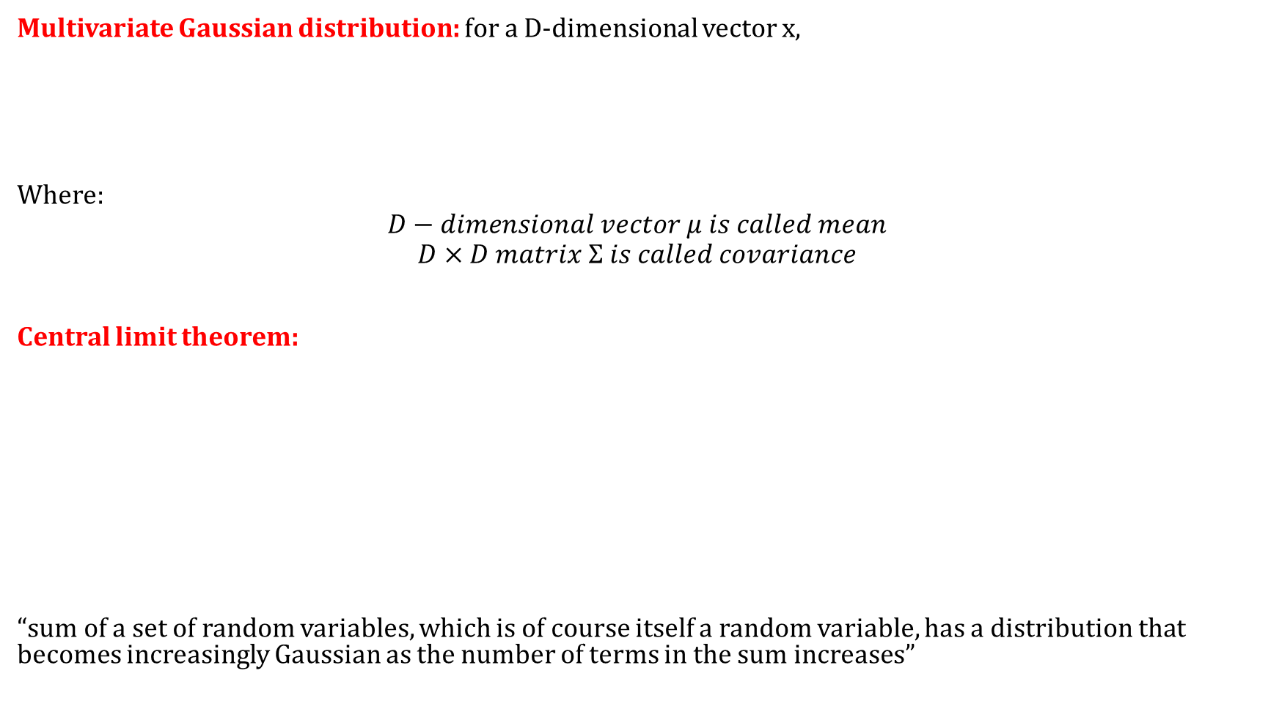
Multivariate Gaussian distribution: for a D-dimensional vector x,
Where:
$$D−dimensional vector μ is called mean$$
$$D×D matrix Σ is called covariance$$
Central limit theorem:
“sum of a set of random variables, which is of course itself a random variable, has a distribution that becomes increasingly Gaussian as the number of terms in the sum increases”

Slide 14
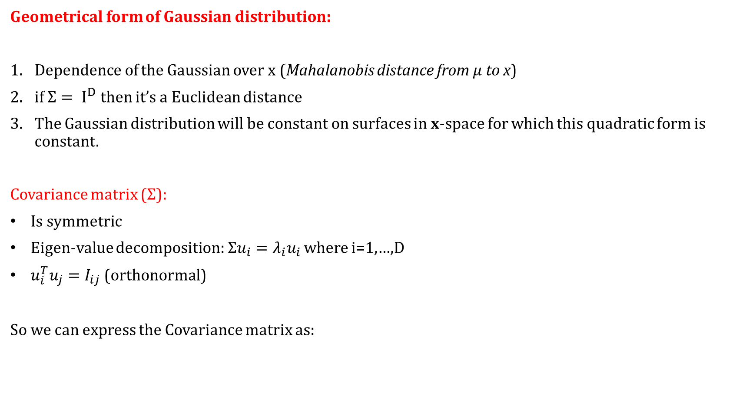
Geometrical form of Gaussian distribution:
Dependence of the Gaussian over x (Mahalanobis distance from $μ$to x)
if $Σ= I^{D}$ then it’s a Euclidean distance
The Gaussian distribution will be constant on surfaces in x-space for which this quadratic form is constant.
Covariance matrix ($Σ$):
Is symmetric
Eigen-value decomposition: $Σu_{i}=λ_{i}u_{i}$ where i=1,…,D
$u_{i}^{T}u_{j}=I_{ij}$ (orthonormal)
So we can express the Covariance matrix as:

Slide 15
Inverse of the covariance:
By substituting we will get Where
The red curve shows the elliptical surface of constant probability.
The axes are defined by the eigenvectors u_{i} of the covariance
matrix, with corresponding eigenvalues λ_{i}.
Orthogonal matrix
New coordinate system

Slide 16
Expectation of x under gaussian distribution:
Where:
Second order expectation:
The covariance: where

Slide 17
Contours of constant probability density for a Gaussian distribution in two dimensions in which the covariance matrix is (a) of general form, (b) diagonal, in which the elliptical contours are aligned with the coordinate axes, and (c) Isotropic, proportional to the identity matrix, in which the contours are concentric circles .

Slide 18
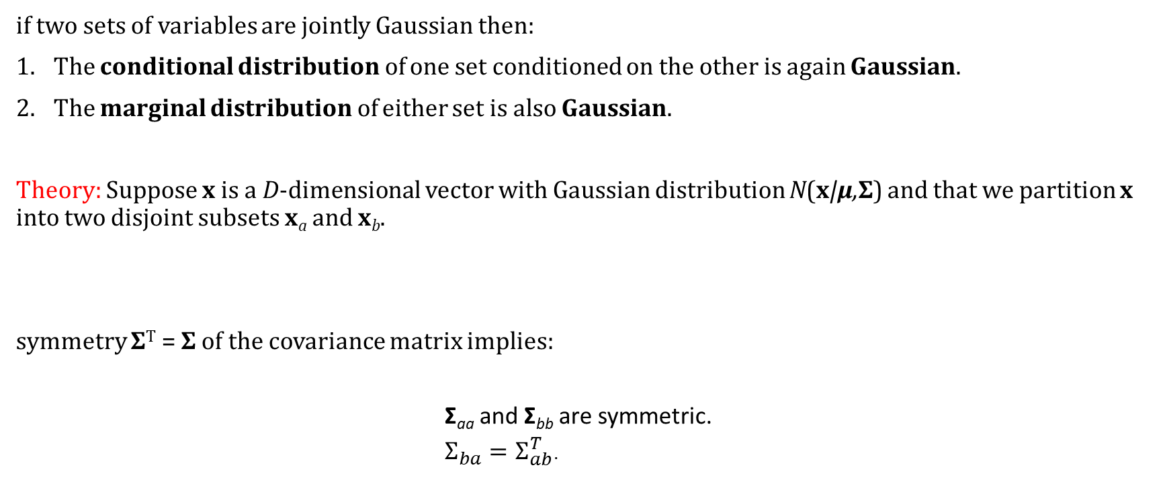
Conditional Gaussian distributions
if two sets of variables are jointly Gaussian then:
The conditional distribution of one set conditioned on the other is again Gaussian.
The marginal distribution of either set is also Gaussian.
Theory: Suppose x is a D-dimensional vector with Gaussian distribution N(x|μ,Σ) and that we partition x into two disjoint subsets x_{a} and x_{b}.
symmetry Σ^{T} = Σ of the covariance matrix implies:
Σ_{aa} and Σ_{bb} are symmetric.
$Σ_{ba}=Σ_{ab}^{T}$.

Slide 19

Let’s define Precision matrix:
$Λ_{aa}$ is not simply taken as inverse of $Σ_{aa}$
The conditional distribution of $x_{a}$ of $x_{b}$is also gaussian:
$${p(x}_{a}\left|x_{b}\right)=N(x_{a}|μ_{a|b}, Σ_{a|b})$$
Where:
Linear function of x_{b}
Independent of x_{a}

Slide 20
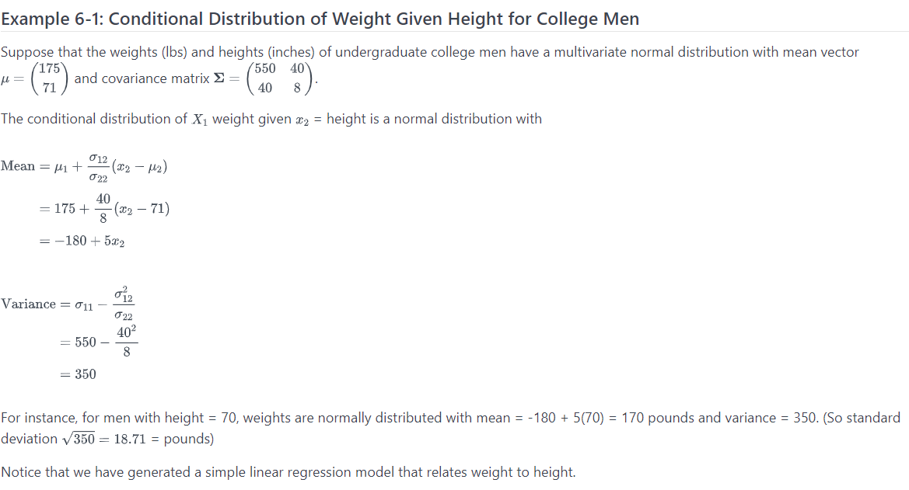

Slide 21

Marginal Gaussian distribution:
If a joint distribution p(x_{a}, x_{b}) is Gaussian, then the conditional distribution ${p(x}_{a}\left|x_{b}\right)$will again be Gaussian.
Turns out that marginal distribution given by is also Gaussian:

Slide 23

Maximum likelihood for the Gaussian
Given a data set X = (x₁, . . . , x_{N})^{T} in which the observations {x_{n}} are assumed to be drawn independently from a multivariate Gaussian distribution
Sufficient statistics
solve for $μ:$
And for $Σ$:

Slide 24
Expectations of the maximum likelihood under the true distribution:
True mean:
Bias estimate:
Unbiased estimate:
Sequential Estimation:
Sequential estimation allow data points to be processed one at a
time and then discarded and are important for on-line applications,
and Also where large data sets are involved so that batch processing
of all data points at once is infeasible.
Previous estimate
Error signal

Slide 25

Student t-distribution
Where:
$λ$ is called precision
$ν$ is called degree of freedom
For the case of:
ν = 1, the t-distribution reduces to the Cauchy distribution.
ν →∞ the t-distribution becomes a Gaussian N(x|μ, λ−1) with mean μ and precision λ.

Slide 26
This leads to property of robustness which means is not sensitive to outliers (green line is Gaussian and red line is T-students)
Where:
Squared Mahalanobis distance

Slide 27
Mixture of Gaussians

Slide 28

Mixture of Gaussians:
Each component has its own $μ_{k}$ and $Σ_{k}$
$π_{k}$is called mixing coefficients where $∀π_{k}≥0$
Component of mixture

Slide 29
Maximum likelihood estimation:
The form of the Gaussian mixture distribution is governed by the parameters π, μ and Σ, where we have used the notation π ≡ {π₁, . . . , π_{K}}, μ ≡ {μ₁, . . . ,μ_{K}} and Σ ≡ {Σ₁, . . .Σ_{K}}.
log of the likelihood function:
The maximum likelihood solution for the parameters no longer has a closed-form analytical solution.
Iterative numerical optimization techniques (alternative solutions)
Expectation maximization (alternative solutions)

Slide 30
Exponential Families
The exponential family of distributions over x, given parameters η, is defined to be the set of distributions of the form
Where:
x may be scalar or vector and may be discrete or continuous.
η (eta) are called the natural parameters of the distribution.
u(x) is some function of x.
g(η) is the normalization coefficient that satisfies:

Slide 31
Prove Bernoulli as exponential family:

Slide 32
Multinomial distribution:
consider the multinomial distribution that, for a single observation x, takes the form:
for
Where:

Slide 33

We know that So we can write:
We can solve:
Which gives us:
By solving for $μ_{k}$ we will get the SoftMax function:
Which gives us:

Slide 34
Gaussian distribution:
We can write the univariate Gaussian distribution as:
Which after simplification can be written in form of exponential:
Where:

Slide 35

Maximum likelihood:
To estimate the parameter $η$ of the
Taking derivative of both sides of We have:
With rearranging we get:
Thus:
E[u(x)]

Slide 36
Now consider a set of independent identically distributed data denoted by X = {x₁, . . . , x_{n}}, for which the likelihood function is given by:
Setting the gradient of ln p(X|η) with respect to η to zero, we get the following condition to be satisfied by the maximum likelihood estimator η_{ML}
Sufficient statistics

